Slide 1
Related & Related table
Related & Related table

Slide 2
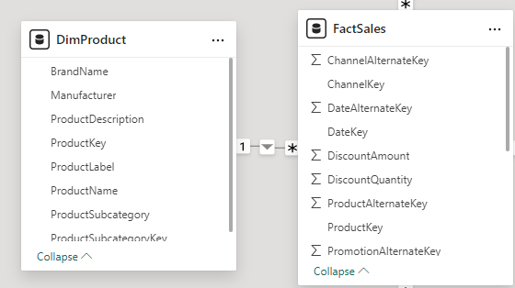
Related & Related Table
Note: This demo uses the DimProduct and FactSales tables .
Note that the relationship between DimProduct and FactSales is one-to-many.

Slide 3
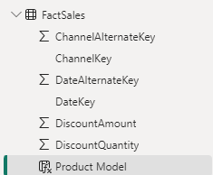
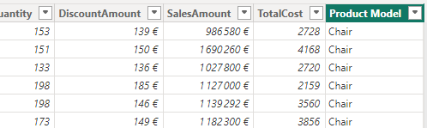
Related & Related Table
Add a new calculated column to the FactSales table called "Product Model" .
Product Model= RELATED ( DimProduct [ BrandName ] )
"Product Model" column must be located at the FactSales table level .

Slide 4
Related & Related Table
DimProduct level from FactInternetSales , we consider the representation of the product's last date key at the column level.
Create a column named "Last Date Key" which represents the last date key.
Last Date Key = MAXX ( RELATEDTABLE ( FactSales ), MAX ( FactSales [ DateKey ] ))
Note that a column has been added to the column collection called "Last Date Key" , which contains values corresponding to the last boarding date.

Slide 5
Thank you
Thank you

